Slide 1
BCS1520: Statistics
Lecture 04:
Causality

Slide 2
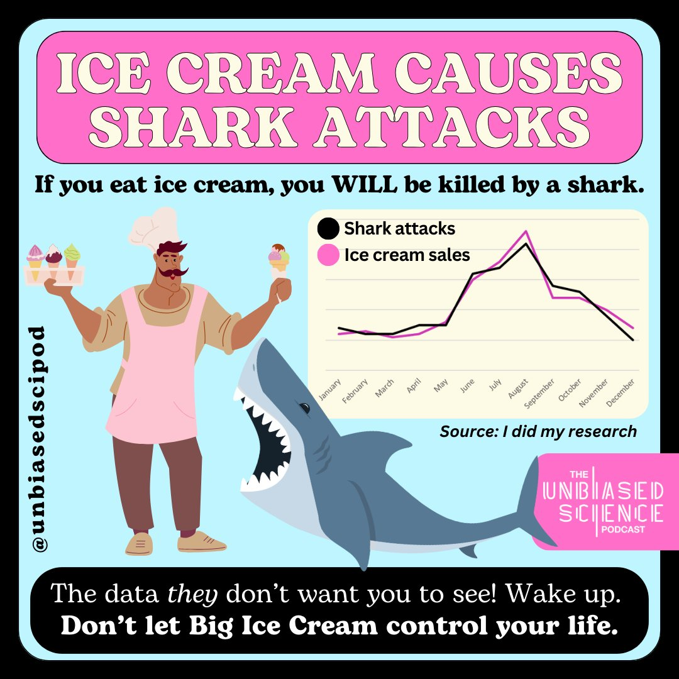
Shark attacks and Ice Cream
Unbiased Science Podcast

Slide 3
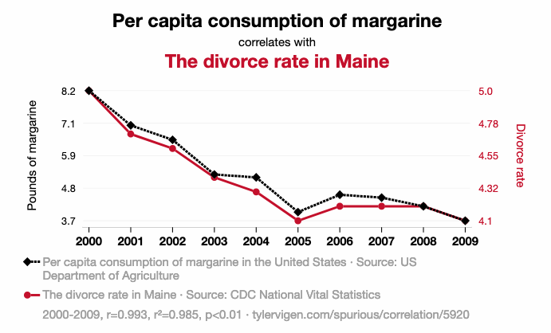
Eating Margarine and Divorce in Maine
Tyler Vigen: Spurious Correlations

Slide 4
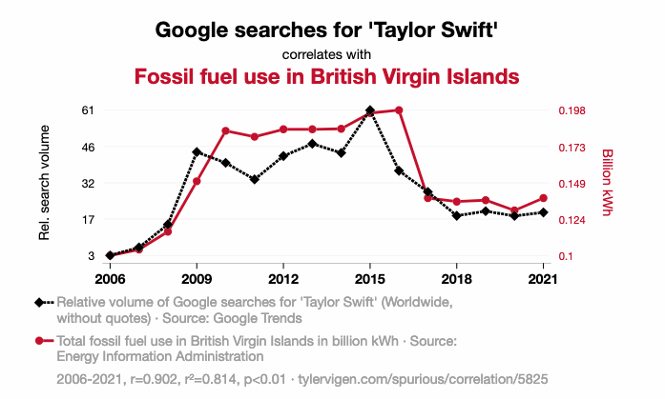
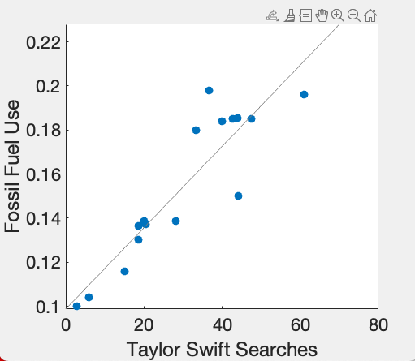
Taylor Swift and Fossil Fuel Use
Tyler Vigen: Spurious Correlations

Slide 5
Correlations : What are they?
Pearson Correlation Coefficient: A number between [-1,1] expressing how close to a straight line the dots fall when two sets of data are plotted against one another.
X-axis: Independent Variable/ Predictor/ Explanatory variable/Fixed Effect
Y-Axis: Dependent Variable/Response

Slide 6
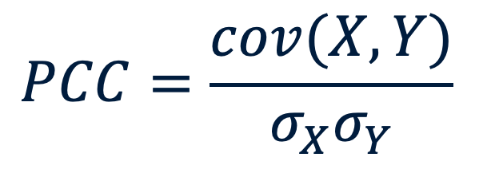
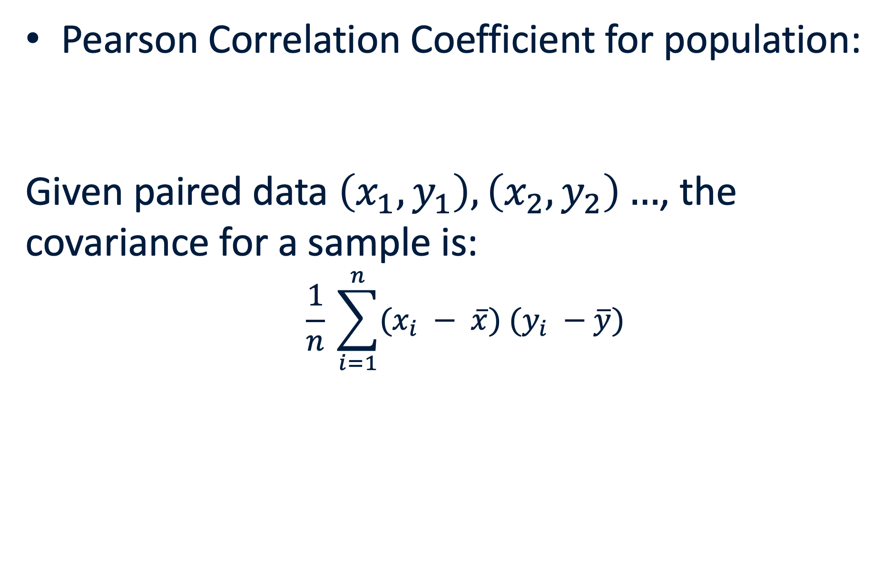
Correlations : What are they?
Pearson Correlation Coefficient for population:
Given paired data $\left(x_{1},y_{1}\right), \left(x_{2},y_{2}\right)…$, the covariance for a sample is:
$$\frac{1}{n} \sum_{i=1}^{n}{(x_{i} − \overline{x}) (y_{i} −\overline{y})}$$
$$PCC=\frac{cov(X, Y)}{σ_{X}σ_{Y}}$$

Slide 7
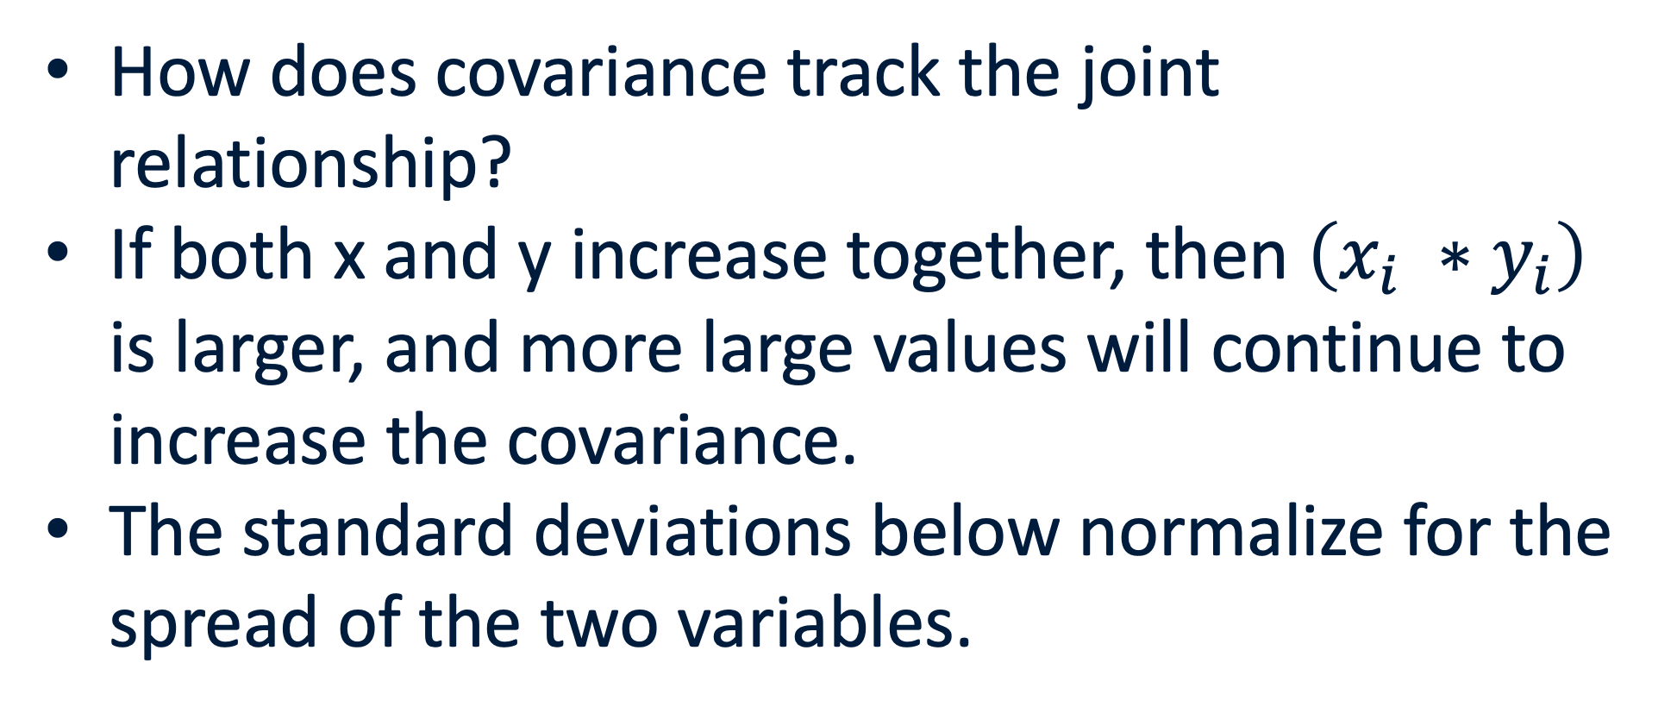
Correlations : What are they?
How does covariance track the joint relationship?
If both x and y increase together, then $\left(x_{i} ∗y_{i}\right)$ is larger, and more large values will continue to increase the covariance.
The standard deviations below normalize for the spread of the two variables.

Slide 8
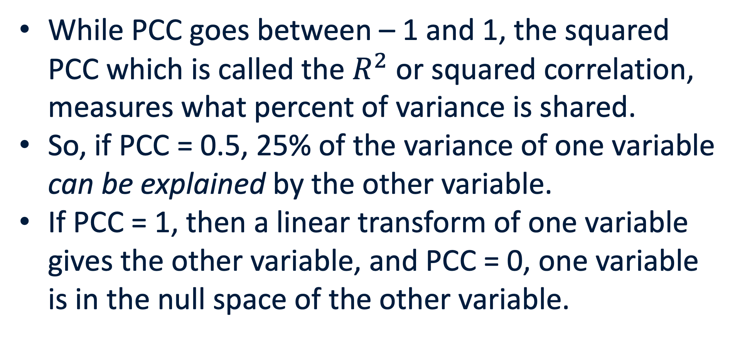
Correlations : What are they?
While PCC goes between – 1 and 1, the squared PCC which is called the $R^{2}$ or squared correlation, measures what percent of variance is shared.
So, if PCC = 0.5, 25% of the variance of one variable can be explained by the other variable.
If PCC = 1, then a linear transform of one variable gives the other variable, and PCC = 0, one variable is in the null space of the other variable.

Slide 9
Correlations : What are they?
Definition
Independent Variable (x-axis): A variable that is fixed by design or observation and whose association with an outcome is of interest.
Definition
Dependent Variable (y-axis): The outcome that we are probably measuring to understand how the independent variable influences it.
Notes:
Fossil fuel use is not reall a dependent variable here.

Slide 10
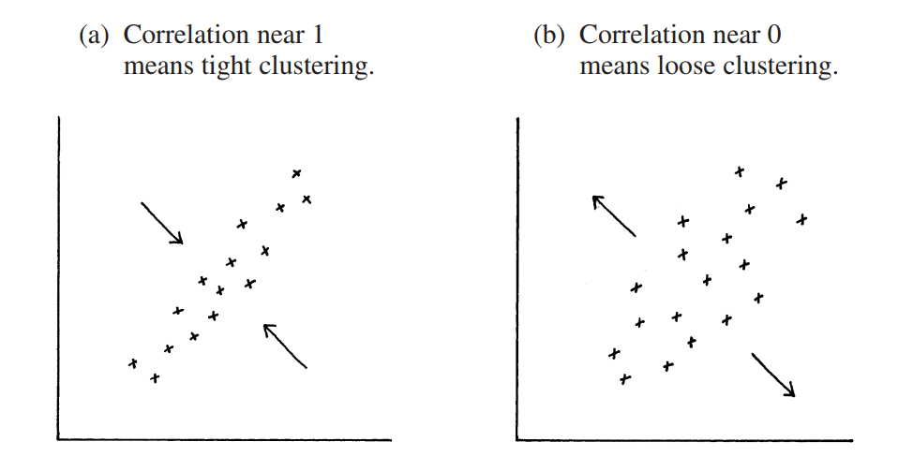
Correlations
Or -1

Slide 11
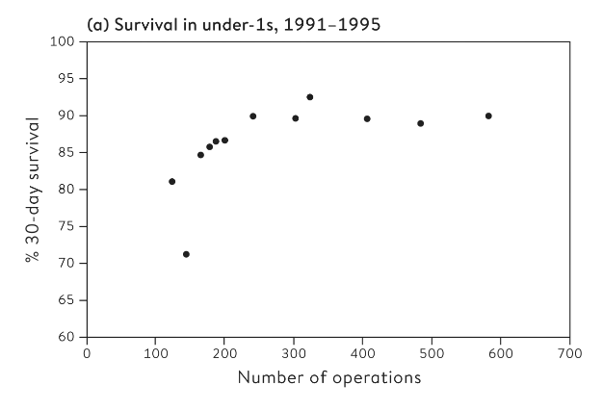
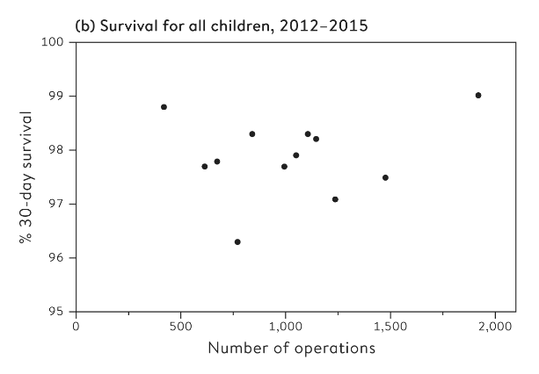
Correlations don’t work for nonlinear relationships
Notes:
PCC = 0.59, Spearman’s rank correlation = 0.85
PCC = 0.17, Spearman’s rank correlation = 0.03; however if you drop the hospital that looks like an outlier, then PCC = 0.42 (driven perhaps by the outlier).

Slide 12
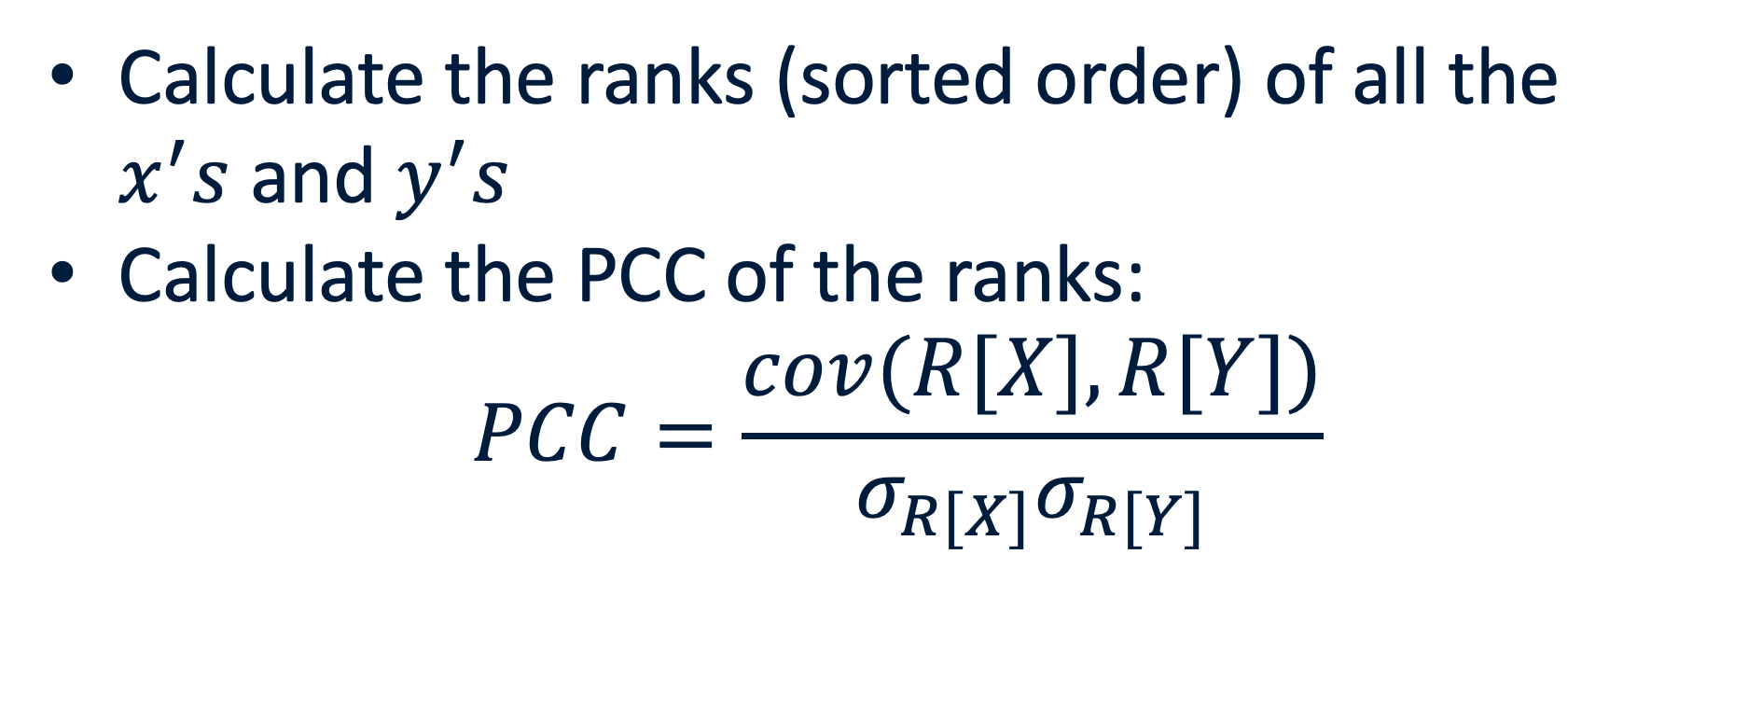
Spearman’s Rank Correlation
Calculate the ranks (sorted order) of all the $x^{′}s$and $y^{′}s$
Calculate the PCC of the ranks:
$$PCC=\frac{cov(R[X], R[Y])}{σ_{R[X]}σ_{R[Y]}}$$

Slide 13
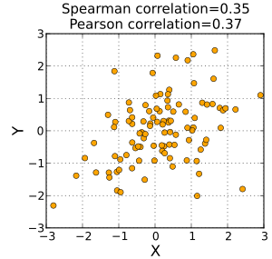
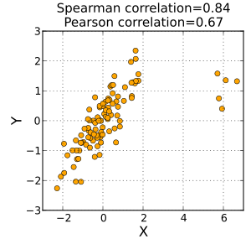
Spearman’s Rank Correlation

Slide 14
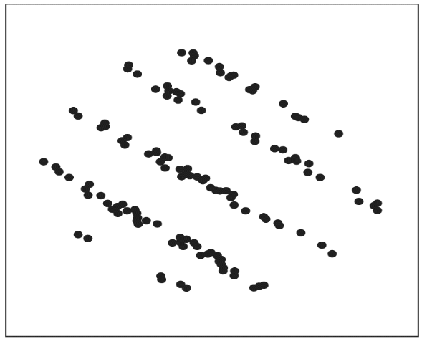
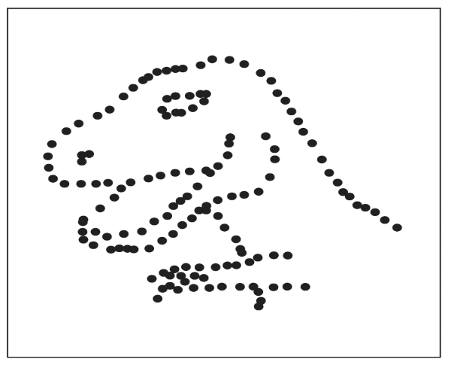
Datasaurus Dozen

Slide 15

Datasaurus Dozen

Slide 16
Correlations : Are they causal?
Things that are causally linked probably are strongly correlated.
Things that are correlated need not be causally linked. At least not directly.

Slide 17
Datasaurus Dozen
ALWAYS LOOK AT YOUR DATA!
Notes:
Same summary statistics across both
Correlation is close to zero for both.
But clearly in the firt there is some relationship we are missing since there are groups.

Slide 18
Shark attacks and Ice Cream
Unbiased Science Podcast
Notes:
summer

Slide 19

Going to university increases risks of Brain Tumors
Huge study with millions of subjects.
Men (women) with university degrees were 19% (23%) more likely to get tumors.
“Completeness of cancer registration and detection bias are potential explanations for the findings”
Notes:
So far we’ve been considering the numerical relationships, but causality is something we can think about for exposure as well – that is, for proportions.
Clearly you should all drop out.

Slide 20
What is causation?
A thorny philosophical problem.
But also, experientially easy to define, that is, we each know for ourselves when we cause something.
And that’s the definition that statistics uses: If you do something that changes something else, then that points to a causal link.
Notes:
Starting from Aristotle all the way to the modern day, there are many views on causation.

Slide 21
What is causation?
Definition
Statistical Causation: When we say that X causes Y, we do not mean that every time X occurs, then Y will too. Or that Y will only occur if X occurs. We simply mean that if we intervene and force X to occur, then Y tends to happen more often. We can never say that X caused Y in a specific case, only that X increases the proportion of times that Y happens.
So, can you increase shark attacks to increase ice cream sales?
Can you decrease margarine use to reduce divorces?
Can you increase brain tumors with university?

Slide 22
Kids and causal experimentation
The idea that is at the core of intelligence: competence without comprehension as a result of causal intervention.
You do a thing and see if it changes anything. And keep doing that.
Kids are great at doing this to understand the world.
Notes:
Making sounds.

Slide 23
What is causation?
If you do something to X that changes Y, with some consistency, then that points to a causal link.
How can we be sure though?
For example, if I push over a vase and it breaks, I assume I caused it to happen.
But how do I know that this wouldn’t have happened anyway? That the vase would’ve just broken on its own?

Slide 24
What is causation?
But how do I know that this wouldn’t have happened anyway? That the vase would’ve just broken on its own?
This is called a counter-factual. That there exists a world where the vase breaks even if I did not push it over.
This defies our understanding of the world of course, but this is useful statistical reasoning.

Slide 25
What is causation?
Counterfactuals are like the metaphorical populations: useful fictions that let us make better data-driven decisions.
Defining cause based on intervention is difficult in real-life: the counter-factuals can’t actually occur, and then we need statistics.

Slide 26
What is causation?

Slide 27
Do tablets increase schoolkids performance?
For the true improvement, we need to have exactly the same school and exactly the same kids both have and not have tablets.
This isn’t possible.
The best we can do is to randomly pick schools such that any bias is accounted for between schools given tablets and those not given tablets.

Slide 28
Randomization: The Heart of Causal Analysis
When we randomize over who gets a treatment or not, we make the potential outcomes independent of the treatment.
This means that the group given treatment and group not given treatment are comparable.
This sounds confusing but really all it is saying is there’s no bias in who is receiving treatment.

Slide 29
What does random mean?
Perhaps it means if we have a set of schools, we assign each of them a number and can select among them equally.
So, each school effectively had the same probability of being chosen as any other.
When would this fail?

Slide 30
Do COVID vaccines reduce the risk of COVID?
If I got COVID despite being vaccinated, how do I know how many times I was at risk and DIDN’T get COVID?
The developers of the vaccine had to run a clinical trial to do a ‘fair test’.

Slide 31
Clinical Trial Principles
Controls: We need to give the vaccine to some and not to others. This group not getting the vaccines should not know they don’t get the vaccine but a placebo.
Allocation of Treatment.
People should be counted in the groups they were assigned to.
People should be blinded to their group.
Groups should be equally treated.
People doing the final assessment shouldn’t know which group the subjects are in.
Measure everyone.

Slide 32
Clinical Trial Principles
Controls
Allocation of Treatment: Randomly allocate participants to treatment and control. (a randomized controlled trial or RCT). Accounts for unknown unknowns.
People should be counted in the groups they were assigned to.
People should be blinded to their group.
Groups should be equally treated.
People doing the final assessment shouldn’t know which group the subjects are in.
Measure everyone.

Slide 33
Poor Sampling but Usable
Convenience Samples: Taking samples where you can get them. Inevitable in medical studies, but we can still randomize who gets treatment.
Volunteer Samples: Only take people who volunteer, sometimes also inevitable, especially for dangerous drugs.

Slide 34
Clinical Trial Principles
Controls
Allocation of Treatment: Randomly allocate participants to treatment and control. (a randomized controlled trial or RCT).
People should be counted in the groups they were assigned to. Even if they don’t get the vaccine in the end. Measures the act of prescription (less relevant for vaccines).
People should be blinded to their group.
Groups should be equally treated.
People doing the final assessment shouldn’t know which group the subjects are in.
Measure everyone.

Slide 35
Clinical Trial Principles
Controls
Allocation of Treatment: Randomly allocate participants to treatment and control. (a randomized controlled trial or RCT).
People should be counted in the groups they were assigned to.
People should be blinded to their group. So that they don’t do more risky activities assuming they have immunity.
Groups should be equally treated.
People doing the final assessment shouldn’t know which group the subjects are in.
Measure everyone.

Slide 36
Clinical Trial Principles
Controls
Allocation of Treatment: Randomly allocate participants to treatment and control. (a randomized controlled trial or RCT).
People should be counted in the groups they were assigned to.
People should be blinded to their group. So that they don’t do more risky activities assuming they have immunity.
Groups should be equally treated. People getting treatment shouldn’t be examined more or vice-versa.
People doing the final assessment shouldn’t know which group the subjects are in.
Measure everyone.

Slide 37
Clinical Trial Principles
Controls
Allocation of Treatment: Randomly allocate participants to treatment and control. (a randomized controlled trial or RCT).
People should be counted in the groups they were assigned to.
People should be blinded to their group.
Groups should be equally treated.
People doing the final assessment shouldn’t know which group the subjects are in. This could bias the people doing the final assessment into not paying careful attention to vaccinated. Double-blinding.
Measure everyone.

Slide 38
Levels of Blinding
Single-blinding: Participants
Double-blinding: Participants + People monitoring.
Triple-Blinding: Participants + People monitoring + statisticians.

Slide 39
Clinical Trial Principles
Controls
Allocation of Treatment: Randomly allocate participants to treatment and control. (a randomized controlled trial or RCT).
People should be counted in the groups they were assigned to.
People should be blinded to their group.
Groups should be equally treated.
People doing the final assessment shouldn’t know which group the subjects are in.
Measure everyone. Perhaps some people leave the study from side effects, you especially want to capture that.

Slide 40
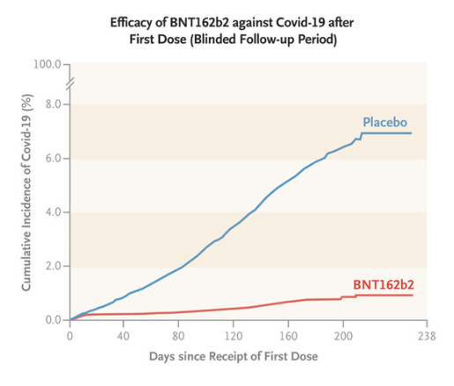
COVID vaccine outcome
Vaccine efficacy was 91%.
In relative risk terms, this mean you have a relative risk of 0.1 in getting the disease compared to unvaccinated.
VE = (1 – RR) * 100
Thomas et al. 2021, NEJM
Notes:
You were 10 times less likely to get the COVID infection if you had a vaccination (mRNA).

Slide 41
Can we be sure the previous plot was not due to chance?
RCTs are our best attempt to remove doubt about a causal link between an intervention and an outcome.
Here, the clinical trial involved tens of thousands of participants and then the outcomes were compared.
So, we are as sure as we can be that this was not due to chance.

Slide 42
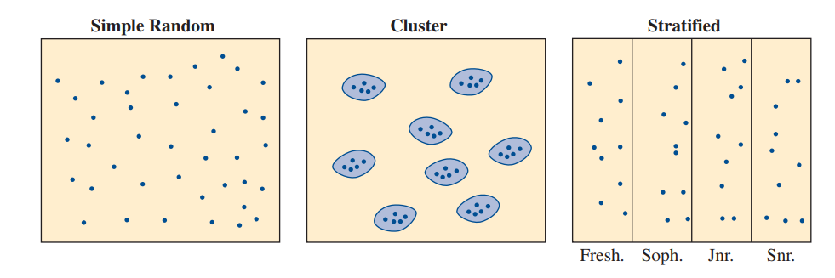
Ways to do randomization
Simple Random Sampling
Cluster Random Sampling
Stratified Random Sampling
Notes:
﻿For instance, suppose you would like to sample about 1% of the families in your city. You could use city blocks as clusters. Using a map to label and number city blocks, you could select a simple random sample of 1% of the blocks and then select every family on each of those blocks for your observations. First actual trial was when using mosquite nets to see if it reduced malaria for Italian railway workers. Clusters were neighbors.
May want to stratify on wealth or race or gender or all three when doing randomized control trials

Slide 43
Stratified Random Sampling
Comes from how random sampling was originally considered.
Ronald Fisher, one of the bigwigs of modern statistics, was trying to decide how to understand the output from different fertilizers.
Plots of land may have less or more drainage and so on and unless you have a huge number of plots (thus correcting for bias), stratification helps correct for known bias

Slide 44
What if we can’t randomize?
For example: we can’t randomize who gets Alzheimer’s (a neurodegenerative disease) and who doesn’t.
So then, how can we figure out what causes Alzheimer’s disease? Assume it is related to say, neurons dying in the brain.

Slide 45
What if we can’t randomize?
Prospective cohort study: Follow people through their lives and measure neuron death through their life and assess whether they get Alzheimer’s later in life.
Retrospective cohort study: Can you find ways to identify whether a group of elderly folks, some with and some without Alzheimer’s had neuron death earlier in life? Say by looking at other medical records.
Case-control study: Find folks who have and don’t have Alzheimer’s and are matched in age, socioeconomic status and so on and assess neuron death across them.

Slide 46
What if we can’t randomize?
For example: Why do old men have big ears?
We can’t actively randomize to understand this.
A first step plan is to look at correlation. In a cross-sectional study, there was a positive correlation.
Definition
Cross-sectional study: when analysis is based solely on the current state of individuals, without any follow-up over time (as opposed to a longitudinal study).

Slide 47
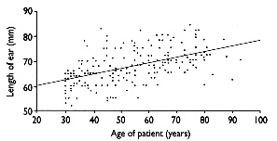
What if we can’t randomize?
Why does this happen?
H: Do ears just grow with age?
H: Did people who are old now always have bigger ears while young have smaller ears for some reason?
H: Do men with smaller ears just die early?

Slide 48
What if we can’t randomize?
Prospective cohort study: Follow young people through their lives and measure ears periodically, do small-eared men die early?
Retrospective cohort study: Can you find ways to identify whether a group of elderly folks, have bigger ears now compared to earlier?
Case-control study: Find men alive and men who are dead who are matched in age, socioeconomic status and so on and assess ear size across them.

Slide 49
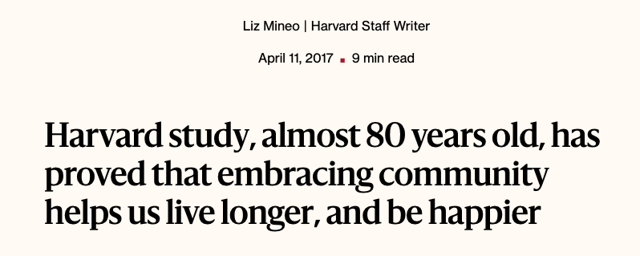
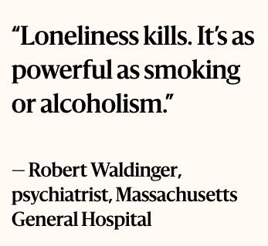
Prospective Cohort Study
https://www.youtube.com/watch?v=8KkKuTCFvzI – What makes a good life?
https://news.harvard.edu/gazette/story/2017/04/over-nearly-80-years-harvard-study-has-been-showing-how-to-live-a-healthy-and-happy-life/
Notes:
Close relationships, more than money or fame, are what keep people happy throughout their lives, the study revealed. Those ties protect people from life’s discontents, help to delay mental and physical decline, and are better predictors of long and happy lives than social class, IQ, or even genes. That finding proved true across the board among both the Harvard men and the inner-city participants.
Several studies found that people’s level of satisfaction with their relationships at age 50 was a better predictor of physical health than their cholesterol levels were.

Slide 50
Returning to the sharks and ice cream: when we can’t randomize, we need to be careful about causality.
There is common confound here: summer.
People are more likely to go to the beach in the summer so they are more likely to be attacked by sharks.
People are also more likely to eat ice cream in the summer.
So we could analyse the correlation on days with similar warm temperature.

Slide 51
Returning to the sharks and ice cream: when we can’t randomize, we need to be careful about causality.
Autism and vaccines: Children tend to be diagnosed around when they are vaccinated. Does vaccination then cause autism? Nope. These events happen around the same age and there are coincidental close occurrences.
Notes:
This is also a good example of scientific malpractice as the doctor who published the article had money to gain (from test kits for a fake disease) from suggesting MMR vaccines caused autism.

Slide 52
Recap

Slide 53

Returning to the sharks and ice cream: when we can’t randomize, we need to be careful about causality.
Definition
Lurking Factors: In epidemiology, an exposure that has not been measured but may be a confounder responsible for some of the observed association: for example, when socioeconomic status has not been measured in a study relating diet with disease or lack of exercise with disease.
X, Y and Z are variables. For example, X and Y may be exercise and mortality while Z is Age. So, more exercise may indeed reduce mortality, but age determines both how much exercise and how likely you are to die.
Notes:
Epidemiology is the study of how and why diseases occur in the population.

Slide 54
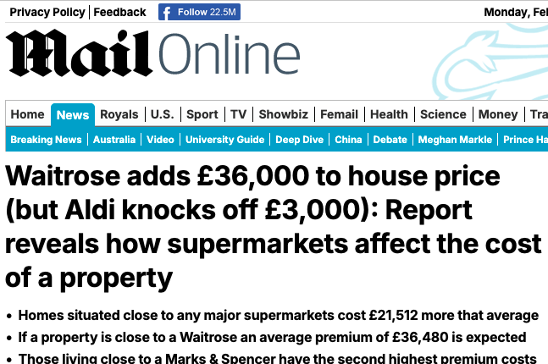
Reverse causation
Expensive Grocery Store
House Prices are Higher
Expensive Grocery Store
House Prices are Higher
Expensive Grocery Store
House Prices are Higher
Notes:
Expensive grocery stores go to expensive neighborhoods.
But if I just used correlation, then house prices seem to increase when an expensive grocery store opens in a neighborhood.
In reality, the causal link is reversed.

Slide 55
Case Study 1: Pellagra
﻿“Pellagra was first observed in Europe in the eighteenth century by a Spanish physician, Gaspar Casal, who found that it was an important cause of ill-health, disability, and premature death among the very poor inhabitants of the Asturias. In the ensuing years, numerous . . . authors described the same condition in northern Italian peasants, particularly those from the plain of Lombardy. By the beginning of the nineteenth century, pellagra had spread across Europe, like a belt, causing the progressive physical and mental deterioration of thousands of people in southwestern France, in Austria, in Rumania, and in the domains of the Turkish Empire. Outside Europe, pellagra was recognized in Egypt and South Africa, and by the first decade of the twentieth century it was rampant in the United States, especially in the south . . . .”

Slide 56
Case Study 1: Pellagra
Pellagra seemed to hit some villages much more than others. Even within affected villages, many households were spared; but some had pellagra cases year after year. Sanitary conditions in diseased households were primitive; flies were everywhere. One blood-sucking fly (Simulium) had the same geographical range as pellagra, at least in Europe; and the fly was most active in the spring, just when most pellagra cases developed. Many epidemiologists concluded the disease was infectious, and—like malaria, yellow fever, or typhus—was transmitted from one person to another by insects. Was this conclusion justified?

Slide 57
Case Study 1: Pellagra

Slide 58
Case Study 1: Pellagra
1914: Joseph Goldberger showed with observational studies and experiments that Pellagra was called by a bad diet.
If people ate foods rich in the P-P factor (now called niacin) then they didn’t get Pellagra.
People who were poor tended to eat a lot of corn, which doesn’t have niacin.

Slide 59
Case Study 1: Pellagra
Diet (Excess Corn)
Low Niacin
Pellagra

Slide 60
Case Study 2: Ultrasound and Low Birth Weight
Human babies are frequently checked with ultrasounds but some work with lab animals showed ultrasound exams can cause low birthweight.
In an observational study, children with ultrasound exposure differed from those without. Even after accounting for confounders.

Slide 61
Case Study 2: Ultrasound and Low Birth Weight

Slide 62
Case Study 2: Ultrasound and Low Birth Weight
Obstetricians suggest ultrasound examinations when something seems to be wrong.
Ultrasound exams and low birthweights had a common cause—problem pregnancies.
An RCT confirmed that ultrasound didn’t harm babies (how would they have done this?).

Slide 63
Case Study 2: Ultrasound and Low Birth Weight
Problem Pregnancies
Low Birthweight
Ultrasound Requested

Slide 64
Matching
There was belief that the reduction in suicides in England from 1964 – 1970 was a result of increase instances of a group called “The Samaritans”. Observational studies that tried to account for confounders couldn’t suggest otherwise, but they used only 15 pairs of towns (one with and one without the group).

Slide 65
Matching
But with a more extensive dataset where the towns were matched better: this meant that other characteristics of the towns were more similar, then the causal effect disappeared.
Can you come up with other lurking factors here that got excluded with matching?
Notes:
Perhaps towns were tending to have more volunteers are places with richer folks? Perhaps socioeconomic status is linked to suicide rates?
Perhaps more institutional support, thus the appearance of this group in the first place, and thtat support helped people anyway.

Slide 66
Sex bias in Graduate Admissions
Definition
Controlling for confounds: When there are differences between groups in observational studies, we can try adjusting for them: called controlling for the confounds/lurking factors, e.g. summer.
8442 men and 4321 women applied to UC, Berkeley during study period
44% of men and 35% of women admitted
Seems like men are preferred.
Notes:
Update the number of men and women.

Slide 67
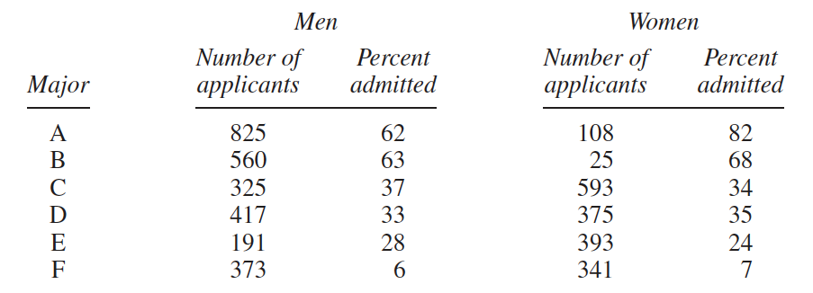
Sex bias in Graduate Admissions
Notes:
But then, it looks like in every major there is a bias towards women really, or at least a limited bias towards them, here we have tried to correct for a confound and found that there was a reversal of the result.
The first two majors were easy to get into. Over 50% of the men applied to these two majors.
• The other four majors were much harder to get into. Over 90% of the women applied to these four majors.

Slide 68
Simpson’s Paradox
When relationships between percentages in subgroups can be reversed when the subgroups are combined.
In the graduate admission case, weighting by relative number of applicants within each program gives us 39% for men and 44% for women.

Slide 69
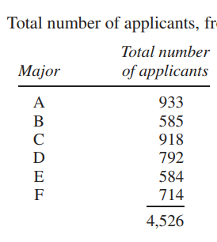
Weighted Means

Slide 70
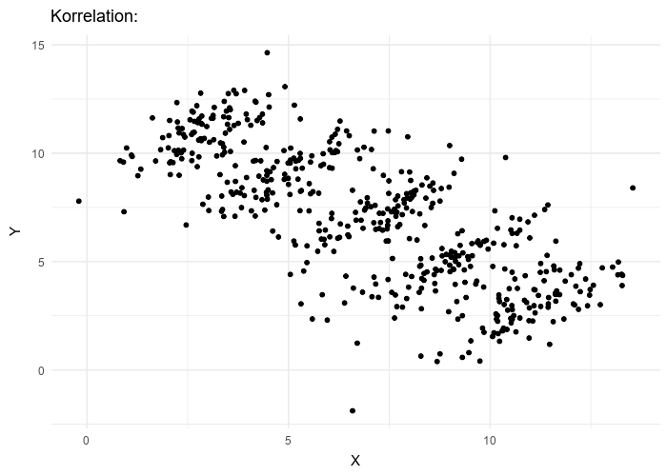
Simpson’s paradox

Slide 71
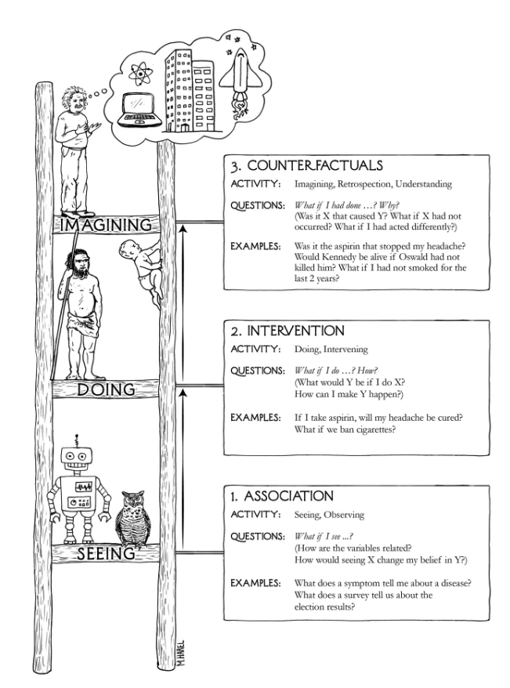
Causal Analysis from Observational Data
Association (e.g. correlation)
Intervention (changing X to see what happens to Y)
Counterfactuals (identifying lurking factors and confounders)
Notes:
The counterfactuals leads to the identification of lurking factors and confounders.
Why do we need to think about counterfactuals after doing an intervention? Didn’t I already suggest that just doing an intervention is enough for judging causal influence?
Yes but counterfactuals include the alternate reality where we did NOT do the intervention. The world where we DID NOT push over the vase. So counterfactuals include both the intervention and what would have happened otherwise and can help us answer both questions. What if we had NOT generated the COVID vaccine - my partner is just writing a paper on exactly that counterfactual question.

Slide 72
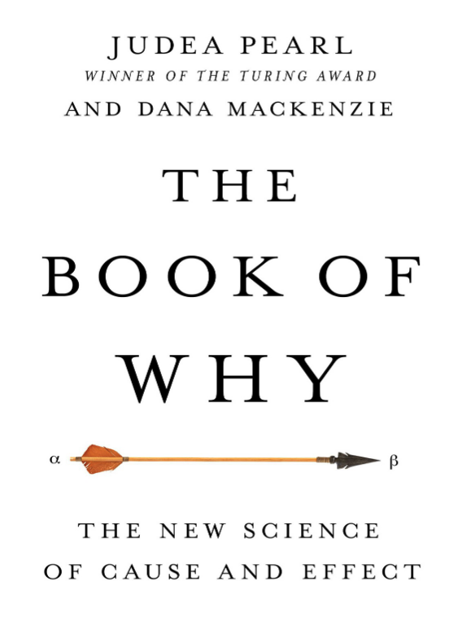
Causation
Good popular science book that makes a strong case for why causal analysis is the bedrock of understanding the world.

Slide 73
Causal Analysis from Observational Data: Horwick et al.
Direct Evidence
Size of effect is so so large that it cannot be explained by plausible confounding.
There is appropriate temporal and/or spatial proximity, in that cause precedes effect and effect occurs after a plausible interval, and/or cause occurs at the same site as the effect.
Dose responsiveness and reversibility: the effect increases as the exposure increases, and the evidence is even stronger if the effect reduces upon reduction of the dose.

Slide 74
Causal Analysis from Observational Data: Horwick et al.
Mechanistic Evidence
There is a plausible mechanism of action: this may be biological, chemical, mechanical or quantum. There is external evidence of a causal chain.
This approach relies on being able to come up with a scientific explanation based on past research and a chain of logic that leads us to believe in the causal effect from observational data.

Slide 75
Causal Analysis from Observational Data: Horwick et al.
3. Parallel Evidence
The effect fits with what is known already.
The effect is found when the study is replicated.
The effect is found in similar, but not identical, studies.
For example, mouth ulcers have been observed to occur after aspirin is rubbed within the mouth, say to relieve tooth pain. The effect is dramatic (1a), occurs where rubbed (1b), is a plausible response to an acidic compound (2), is not contradicted by current science and is similar to the known effect of aspirin in causing stomach ulcers (3a), and has been repeatedly observed in multiple patients (3b). So five out of seven guidelines are satisfied, the remaining two have not been tested, and so it is reasonable to conclude this is a genuine adverse reaction to the drug.

Slide 76
Causation
Knowing causal links is what allows us to have agency in the world: that is, knowing that when I pay attention in this lecture, I’m more likely to do well in the test is a causal link. Choosing not to is also causal. At least statistically.
So being able to assess causality from observational data is important. But it can go wrong. So, we need to keep an eye out for mistaken conclusions.
Notes:
You were 10 times less likely to get the COVID infection if you had a vaccination.

